Slide 1
Concurrent Execution
Two authors disk system (Bank)
Balance = Rs 700
OR = Rs 400
Larry to deposit
Rs200/-
Local Balance = Rs 700
Jim to withdraw
Rs100/-
Local Balance = Rs 400

Slide 2
Concurrent Execution
Two authors disk system (Railway Ticket Booking)
Available Ticket = 15
Cricket team access to
Larry
for 15 seats
Hockey team access to
Jim
for 15 seats

Slide 3
Concurrent Execution
Two authors disk system (Railway Ticket Booking)
Available Ticket = 00
Larry
allocates 15 seats to Cricket team
Jim
allocates 15 seats to Hockey team

Slide 4

Class Test
There are two concurrent processes P and Q to run the following code:
Int X= Roll No MODULUS 10;
Begin
S1: Read(X);
S2: X = X + 3;
S3: Write(X);
End
Find out the final value(s) of X and show the possible sequence of execution for each value.

Slide 5
Problems of Concurrency
Processes can execute concurrently
May be interrupted at any time, partially completing execution
Concurrent access to shared data may result in data inconsistency
Maintaining data consistency requires mechanisms to ensure the orderly execution of cooperating processes

Slide 6
Critical Section Problem
Consider system of n processes {p₀, p₁, … p_{n-1}}
Each process has critical section segment of code
Process may be changing shared variables, updating table, writing file, etc
When one process is in critical section, no other may be in its critical section
Critical section problem is to design protocol to solve this
Each process must ask permission to enter critical section in entry section, may follow critical section with exit section, then remainder section

Slide 7
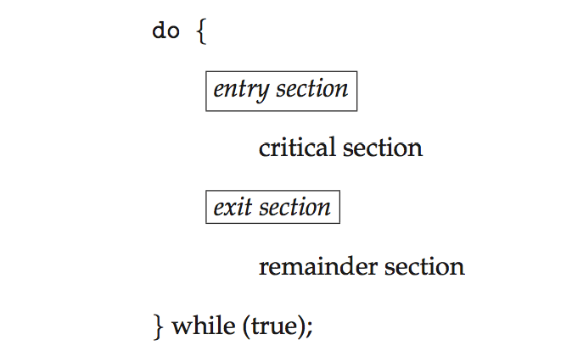
Critical Section
General structure of process P_{i}

Slide 8
Solution to Critical Section Problem
1. Mutual Exclusion - If process P_{i} is executing in its critical section, then no other processes can be executing in their critical sections
2. Progress - If no process is executing in its critical section and there exist some processes that wish to enter their critical section, then one of the processes must enter the critical section next.
3. Bounded Waiting - A bound must exist on the number of times that other processes are allowed to enter their critical sections after a process has made a request to enter its critical section and before that request is granted

Slide 9
Algorithms
Larry's Code
while (turn == Jim) do no-op;
critical section
turn = Jim;
remainder section
Jim's Code
while (turn == Larry) do no-op;
critical section
turn = Larry;
remainder section

Slide 10
contd...
Larry's Code
flag_larry = true; //1
while (flag_Jim ) do no op;
critical section
flag_Larry = false;
remainder section
Jim's Code
flag_jim = true; //a
while (flag_Larry ) do no op;
critical section
flag_Jim = false;
remainder section

Slide 11
contd...
Larry's Code
while (flag_Jim ) do no op;
flag_larry = true;
critical section
flag_Larry = false;
remainder section
Jim's Code
while (flag_Larry) do no op;
flag_jim = true;
critical section
flag_Jim = false;
remainder section

Slide 12
Peterson’s Code
Larry's Code
flag_larry = true; //1
turn = Jim; //2
while (flag_Jim && turn==Jim) ;
critical section
flag_Larry = false;
remainder section
Jim's Code
flag_jim = true; //a
turn = Larry; //b
while(flag_Larry && turn==Larry);
critical section
flag_Jim = false;
remainder section
Sequence: 1, 2, a, b;
a, b, 1, 2;
1, a, b, 2;
1, a, 2, b;
a,1, b, 2

Slide 13
contd...
Provable that the three CS requirement are met:
1. Mutual exclusion is preserved
2. Progress requirement is satisfied
3. Bounded-waiting requirement is met

Slide 14

Semaphore
RED
GREEN
Entry( )
Exit( )
Semaphore is a binary (can also be counting) protected datatype on which two predefined atomic operations are available, such as WAIT( ) and SIGNAL( )

Slide 15
wait() and signal()
wait( ) and signal( ) originally called as P( ) and V( ) on binary values
Semaphore S, mutex, read, wrt;
// Normally initialised to 1 for critical section problem
wait(S):
while (S == 0) do no op;
S=0;
signal(S):
S=1;
Busy-wait solution

Slide 16
wait() and signal() without busy-waiting
wait(S):
if (S == 0)
{ add this process to
waiting list S;
block( );
}
else
S=0;
signal(S):
if (Queue for S in non empty)
{
remove a process P from
waiting list S;
wakeup( );
}
else
S=1;

Slide 17
wait() and signal() uses
use of wait( ) and signal( ) operation for critical section problems
Semaphore mutex=1;
P1
P2
P3
wait(mutex);
critical section;
signal(mutex);
wait(mutex);
critical section;
signal(mutex);
wait(mutex);
critical section;
signal(mutex);

Slide 18
Semaphore Usages
Consider two processes P₁ and P₂ that require P₁ to happen before P_{2 i.e.} P₁ P₂
Create a semaphore “synch” initialized to 0
Semaphore synch = 0;
wait(synch);
code for P₁
code for P₂
signal(synch);

Slide 19
contd...
Create four semaphore variables and initialized to 0
Semaphore ab=0, ac=0, bc=0, bd=0;
P_{A}
P_{B}
P_{C}
P_{D}
code for P_{A}
V(ab);
V(ac);
P(ab);
code for P_{B}
V(bd);
P(ac);
code for P_{C}
V(cd);
P(bd);
P(cd);
code for P_{D}

Slide 20
Violation of Mutual Exclusion
Semaphore S=1;
P(S);
CS for P_{A}
V(S);
P(S);
CS for P_{B}
V(S);
Context switching occurs after execution of first test statement
of the P( ) operation before setting to 0

Slide 21
Violation of Mutual Exclusion
Semaphore S=0;
P(S);
CS for P_{A}
V(S);
P(S);
CS for P_{B}
V(S);
Context switching occurs after execution of first test statement
of the P( ) operation before setting to 0
P( ) operation must be atomic by using
Disable and Enable Interrupt
Test-and-set( ) / fetch-and-set( ) instruction

Slide 22
Enabling and Disabling Interrupt
wait(S):
DI
while (S == 0) do no op;
S=0;
EI
signal(S):
S=1;

Slide 23
test-and-set Instruction
Definition:
boolean test-and-set (boolean *target)
{
boolean rv = *target;
*target = TRUE;
return rv:
}
Executed atomically
Returns the original value of passed parameter
Set the new value of passed parameter to “TRUE”.

Slide 24
test-and-set Use
wait(S):
while (test-and-set(S)) ;
signal(S):
S=0;
Fetch-and-set(S)

Slide 25
Counting Semaphore
Semaphore S=1;
wait(S):
while (S <= 0) do no op;
S--;
wait(S):
S++;
Busy-wait solution

Slide 26
Semaphore Implementation without busy-wait
wait(S):
S--;
if ( )
{ add this process to waiting
list for S;
block( );
}
signal(S):
S++;
if ( )
{
remove a process P from
waiting list S;
wakeup( );
}

Slide 27
Semaphore Implementation without busy-wait
wait(S):
S--;
if (S < 0)
{ add this process to waiting
list for S;
block( );
}
signal(S):
S++;
if (S <= 0)
{
remove a process P from
waiting list S;
wakeup( );
}

Slide 28
Examples on Counting Semaphore
Semaphore S=1;
P(S);
CS for P_{A}
V(S);
P(S);
CS for P_{B}
V(S);
P(S);
CS for P_{C}
V(S);
P(S);
CS for P_{D}
V(S);

Slide 29
Examples on Counting Semaphore
Semaphore S=0;
P(S);
CS for P_{A}
V(S);
P(S);
CS for P_{B}
V(S);
P(S);
CS for P_{C}
V(S);
P(S);
CS for P_{D}
V(S);

Slide 30
Examples on Counting Semaphore
Semaphore S=-1;
P(S);
CS for P_{A}
V(S);
P(S);
CS for P_{B}
V(S);
P(S);
CS for P_{C}
V(S);
P(S);
CS for P_{D}
V(S);

Slide 31
Examples on Counting Semaphore
Semaphore S=-2;
P(S);
CS for P_{A}
V(S);
P(S);
CS for P_{B}
V(S);
P(S);
CS for P_{C}
V(S);
P(S);
CS for P_{D}
V(S);

Slide 32
Examples on Counting Semaphore
Semaphore S=-3;
P(S);
CS for P_{A}
V(S);
P(S);
CS for P_{B}
V(S);
P(S);
CS for P_{C}
V(S);
P(S);
CS for P_{D}
V(S);

Slide 33
Examples on Counting Semaphore
Semaphore S=-2;
P(S);
CS for P_{A}
V(S);
P(S);
CS for P_{B}
V(S);
P(S);
CS for P_{C}
V(S);
P(S);
CS for P_{D}
V(S);

Slide 34
Examples on Counting Semaphore
Semaphore S=-1;
P(S);
CS for P_{A}
V(S);
P(S);
CS for P_{B}
V(S);
P(S);
CS for P_{C}
V(S);
P(S);
CS for P_{D}
V(S);

Slide 35
Examples on Counting Semaphore
Semaphore S=0;
P(S);
CS for P_{A}
V(S);
P(S);
CS for P_{B}
V(S);
P(S);
CS for P_{C}
V(S);
P(S);
CS for P_{D}
V(S);

Slide 36
Examples on Counting Semaphore
Semaphore S=1;
P(S);
CS for P_{A}
V(S);
P(S);
CS for P_{B}
V(S);
P(S);
CS for P_{C}
V(S);
P(S);
CS for P_{D}
V(S);

Slide 37
Classical Problems of Synchronization
Classical problems
Bounded-Buffer Problem
Readers and Writers Problem
Dining-Philosophers Problem

Slide 38
Bounded-Buffer Problem
n buffers, each can hold one item
Binary Semaphore mutex initialized to the value 1
Counting Semaphore full initialized to the value 0
Counting Semaphore empty initialized to the value n

Slide 39
semaphore mutex=1;
Producer code
Consumer code
do
wait(mutex);
/* add next item to the buffer */
signal(mutex);
while (true);
do
wait(mutex);
/* remove next item from the buffer */
signal(mutex);
while (true);

Slide 40
semaphore mutex=1;
semaphore empty=10, full=0;
Producer code
Consumer code
do
wait(empty);
wait(mutex);
/* add next item to the buffer */
signal(mutex);
signal(full);
while (true);
do
wait(full);
wait(mutex);
/* remove next item from the buffer */
signal(mutex);
signal(empty);
while (true);

Slide 41
semaphore mutex=1;
semaphore empty=0, full=10;
Producer code
Consumer code
do
wait(empty);
wait(mutex);
/* add next item to the buffer */
signal(mutex);
signal(full);
while (true);
do
wait(full);
wait(mutex);
/* remove next item from the buffer */
signal(mutex);
signal(empty);
while (true);

Slide 42
Readers-Writers Problem
A data set is shared among a number of concurrent processes
Readers – only read the data set; they do not perform any updates
Writers – can both read and write
Problem – allow multiple readers to read at the same time
Only one single writer can access the shared data at the same time

Slide 43
Readers-Writers Problem
To implement solution:
Semaphore wrt initialized to 1
Semaphore mutex initialized to 1
Integer read_count initialized to 0

Slide 44
contd...
Readers' Code
Writers' Code code
wait(mutex);
read_count++; if(read_count == 1) wait(wrt); signal(mutex);
..
/*reading is performed*/
...
wait(mutex); read_count--; if(read_count == 0) signal(wrt);
signal(mutex);
wait(wrt);
..
/* write onto the book*/
..
signal(wrt);

Slide 45
Readers-Writers Problem Variations
First variation – no reader kept waiting unless writer has permission to use shared object
Second variation – once writer is ready, it performs the write ASAP
Both may have starvation leading to even more variations
Problem is solved on some systems by kernel providing reader-writer locks

Slide 46
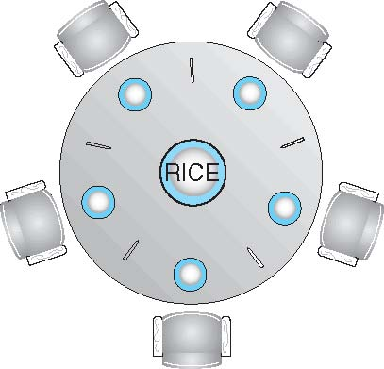
Dining-Philosophers Problem
Philosophers spend their lives alternating thinking and eating
Occasionally try to pick up 2 chopsticks (one at a time) to eat from bowl
Need both to eat, then release both when done
In the case of 5 philosophers
Semaphore chopstick[5] initialized to 1

Slide 47
Dining-Philosophers Problem Algorithm
i^{th} Philosopher solution:
wait (chopstick[i] );
wait (chopStick[ (i + 1) % 5] );
// eat
signal (chopstick[i] );
signal (chopstick[ (i + 1) % 5] );
// think
Problem with this algorithm?
Philosopher: P0 P1 P2 P3 P4
chopstick [0] [1] [2] [3] [4]

Slide 48
contd...
Deadlock handling
Allow a philosopher to pick up the forks only if both are available (picking must be done in a critical section).
Use an asymmetric solution -- an odd-numbered philosopher picks up first the left chopstick and then the right chopstick. Even-numbered philosopher picks up first the right chopstick and then the left chopstick.
Allow at most 4 philosophers to be sitting simultaneously at the table.

Slide 49
Deadlock free Dining-Philosophers Solution
i^{th} Philosopher solution:
DI
wait (chopstick[i] );
wait (chopStick[ (i + 1) % 5] );
EI
// eat
signal (chopstick[i] );
signal (chopstick[ (i + 1) % 5] );
// think

Slide 50
Deadlock free Dining-Philosophers Solution
i^{th} Philosopher solution:
wait(mutex)
wait (chopstick[i] );
wait (chopStick[ (i + 1) % 5] );
signal(mutex)
// eat
signal (chopstick[i] );
signal (chopstick[ (i + 1) % 5] );
// think

Slide 51
Deadlock free Dining-Philosophers Solution
i^{th} Philosopher solution:
if(i is odd) {
wait (chopstick[i] );
wait (chopStick[ (i + 1) % 5] ); }
else {
wait (chopStick[ (i + 1) % 5] );
wait (chopstick[i] ); }
// eat
signal (chopstick[i] );
signal (chopstick[ (i + 1) % 5] );
// think

Slide 52
Problems with improper use of Semaphores
Semaphore S=1;
P(S);
CS for P_{A}
V(S);
V(S);
CS for P_{B}
P(S);
P(S);
CS for P_{C}
V(S);
Mutual Exclussion is violated

Slide 53
Monitors

Slide 54
Monitors
A high-level abstraction that provides a convenient and effective mechanism for process synchronization
Abstract data type, internal variables only accessible by code within the procedure
Only one process may be active within the monitor at a time
But not powerful enough to model some synchronization schemes
monitor monitor-name
{
// shared variable declarations
procedure P1 (…) { …. }
procedure Pn (…) {……}
Initialization code (…) { … }
}
}

Slide 55
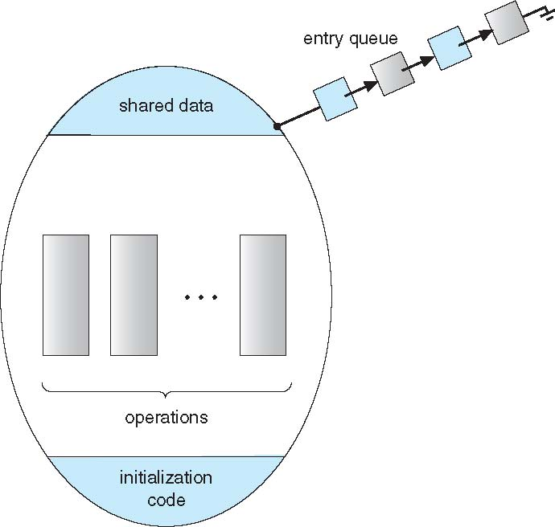
Schematic view of a Monitor

Slide 56


